Slide 1
How to bind serial issues with a work order
Yoel Kortick
Senior Librarian

Slide 2

Agenda
Introduction
The Work Order Department
The Work Order Process

Slide 3
Introduction

Slide 4
Introduction
In addition to this presentation, it is recommended to also see How to define and manage work orders in Alma.pptx
It is possible to bind items in Alma both with and without the use of a Work Order. This presentation will show how this is done using a Work Order.
In both cases, with and without a work order, the items which get bound are "withdrawn" from the repository and a new item is created.
The new item is a "combination" of the withdrawn bound items.

Slide 5
Introduction
For example, if for a serial which is published monthly all 12 issues (items) of a specific volume have arrived, the institution may wish to bind them all into one volume.
When this process occurs in Alma the 12 individual items get withdrawn, and a new item gets created.
The 12 withdrawn items are retrievable via Alma Analytics but not via the Alma user interface.

Slide 6
Introduction
One advantage of doing this process via a Work Order is that specific instructions for the binding may be recorded in the work order and received by the binding department.
Another advantage is that at all times it is possible to track both the location and status of the bound item and the work order.
The work order is performed in the binding department and the statuses through which it follows are fully customizable.

Slide 7
The Work Order Department

Slide 8
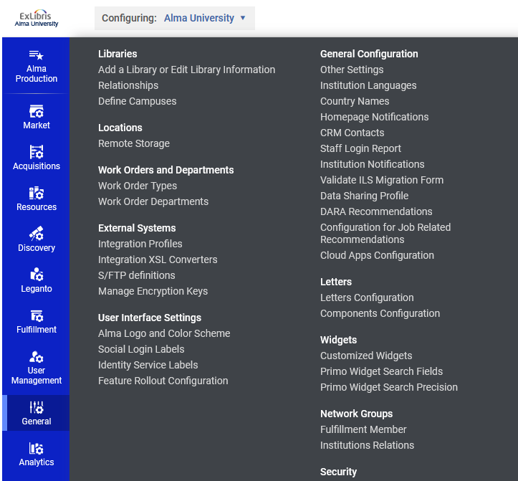
The Work Order Department
The work order department is defined from the General Configuration Menu.
Here it is defined for the Institution and not a specific Library.
Configured on the institution level

Slide 9
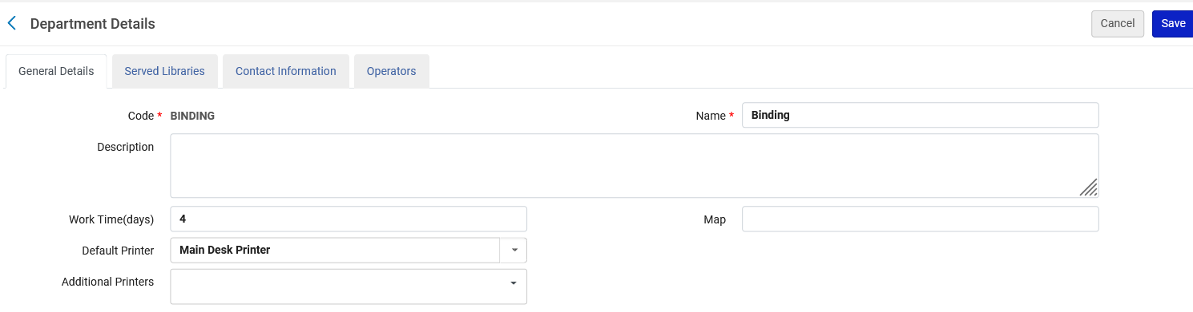
The Work Order Department
Here is the Binding Work Order Department
Number of days it is expected that the items will be in the department

Slide 10
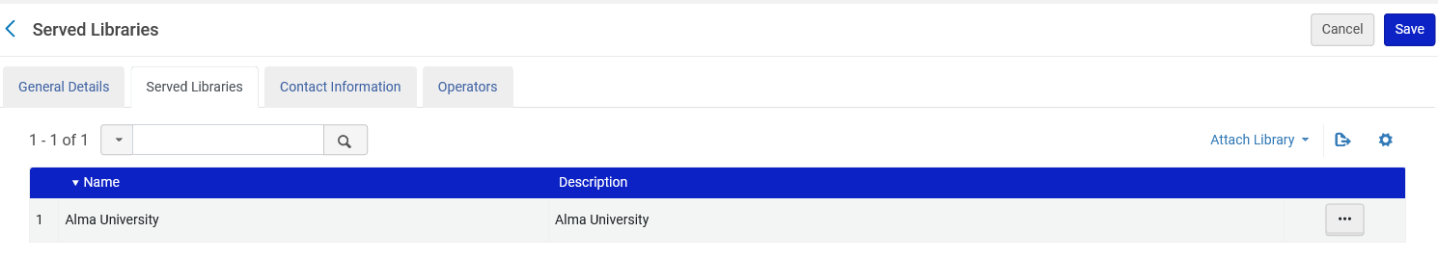
The Work Order Department
The "Served Libraries" are libraries for whom inventory can be handled by the department. Here we have chosen the entire institution.

Slide 11
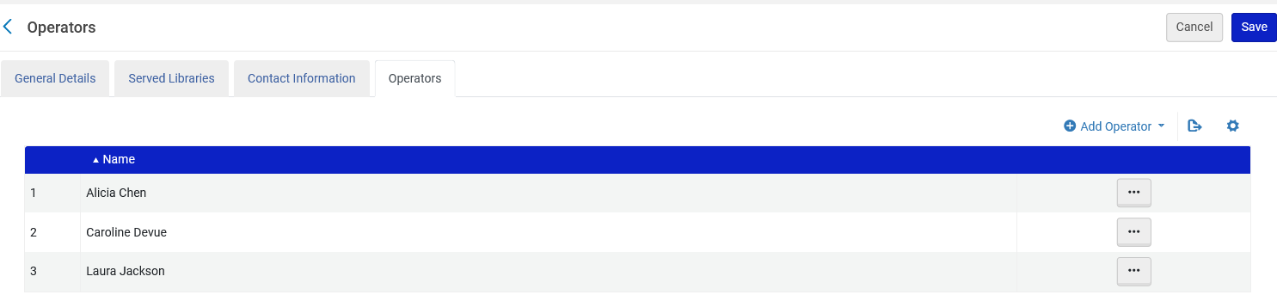
The Work Order Department
The "Operators" are the staff users who work at the department and therefore can change to be "currently at" the department.
The operators appear in the list of roles for the user

Slide 12
The Work Order Department
As is the case for all work order departments, the Binding department has statuses.
These help the institution to track the progress of the work order.
The statuses may be seen and configured by accessing the configuration menu "General > Work order types > Choose specific type > Manage Statuses"

Slide 13
The Work Order Department
We are accessing the Work Order Types so that we may see and configure the statuses.
Configured on the institution level

Slide 14
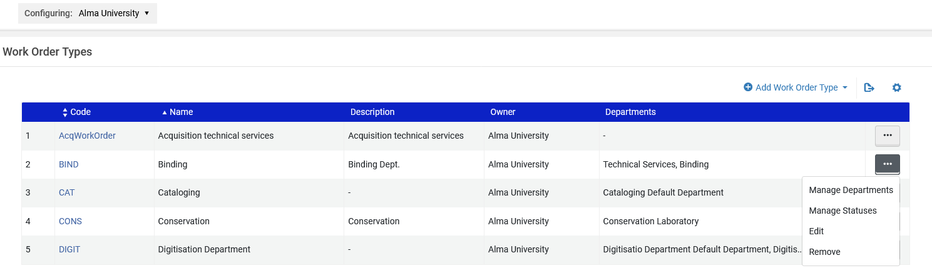
The Work Order Department
We will choose "Manage Statuses" for the Binding Department.

Slide 15
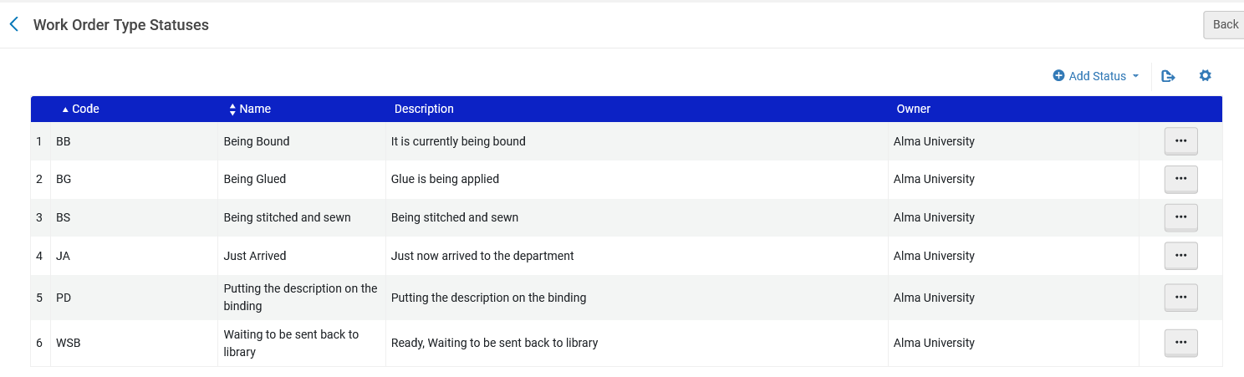
The Work Order Department
These are the statuses which have been defined by this particular institution

Slide 16
The Work Order Process

Slide 17
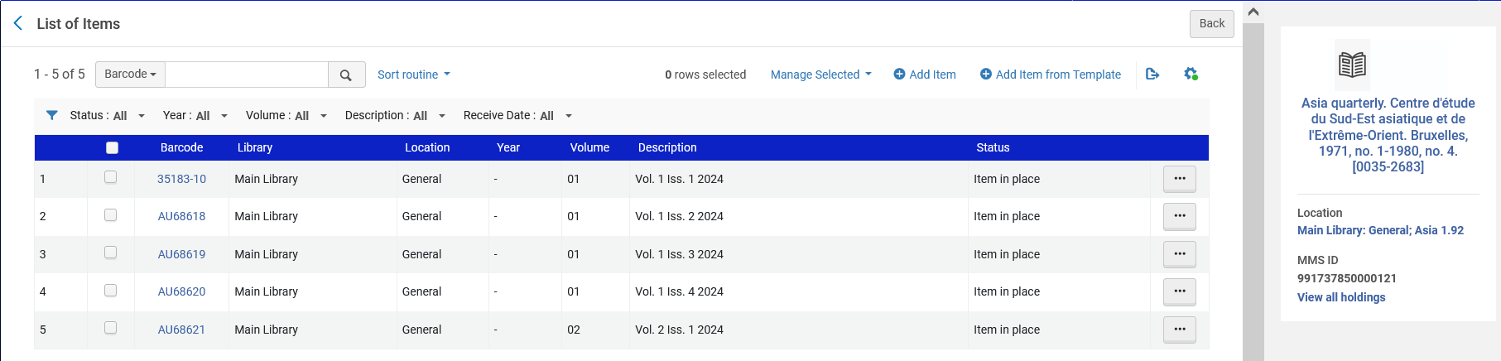
The Work Order Process
For journal "Asia Quarterly " Vol. 1 issues 1-4 (all of vol. 1) as well as vol. 2 issue 1 have arrived.
All of Vol. 1 has arrived
Beginning of Vol. 2 has arrived

Slide 18
The Work Order Process
The institution decides to bind Vol. 1 issues 1-4 into one bound item.
This will be one item

Slide 19
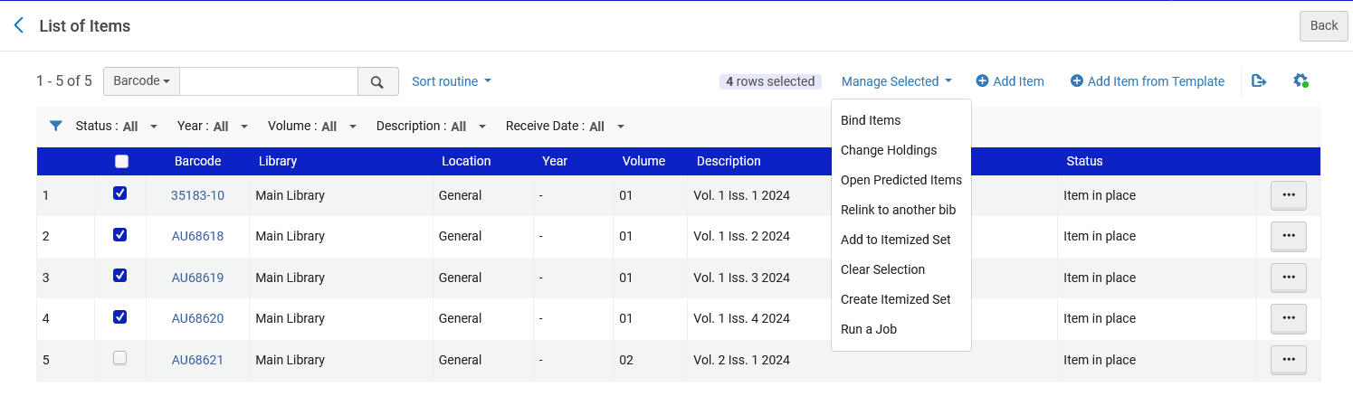
The Work Order Process
From the list of items, the issues which are desired to be bound (all 4 issues of volume 1) are selected and then the staff user chooses "Bind items"

Slide 20
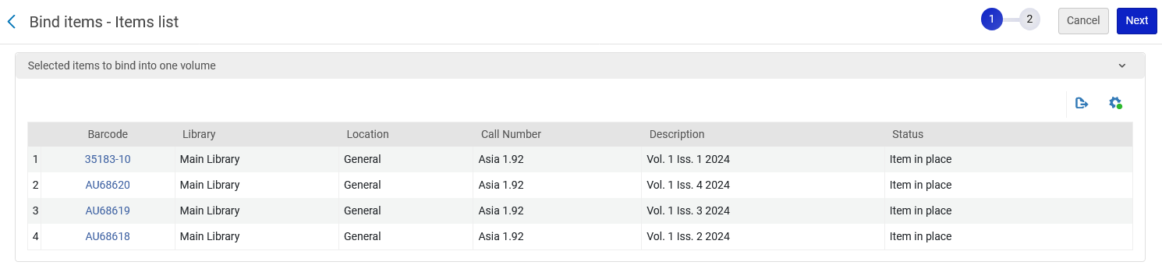
The Work Order Process
The selected items appear and staff user clicks "Next"

Slide 21
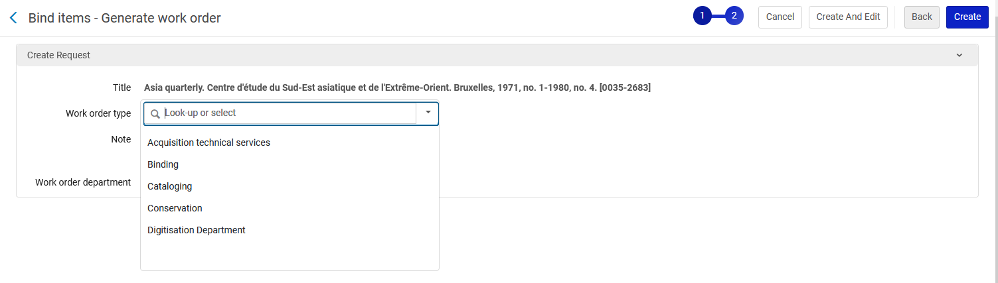
The Work Order Process
For the "Work Order Type" we will select "Binding"

Slide 22
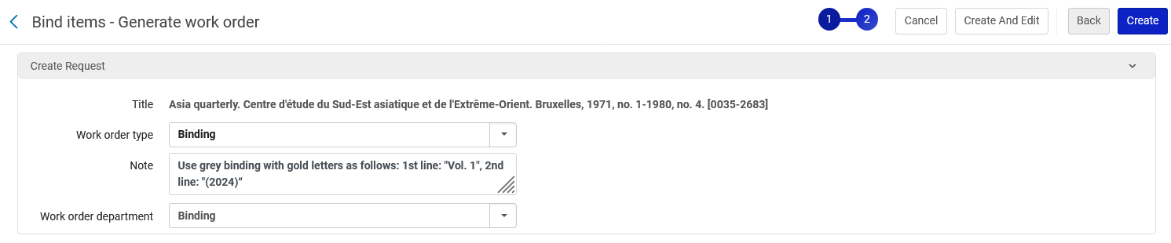
The Work Order Process
In the note field we will add a relevant note:
Use grey binding with gold letters as follows: 1st line: "Vol. 1", 2nd line: "(2024)"
For "Work order department" choose "Binding", then click "Create"

Slide 23
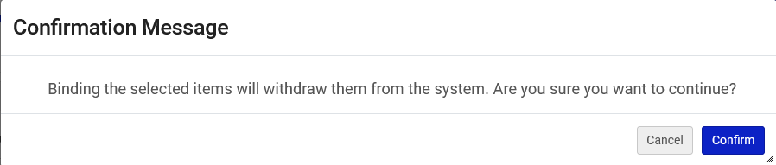
The Work Order Process
User is warned that this will withdraw the bound items from the system and create a new "bound" item

Slide 24
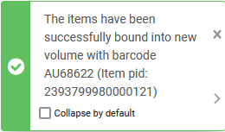
The Work Order Process
We then confirm and receive this message

Slide 25
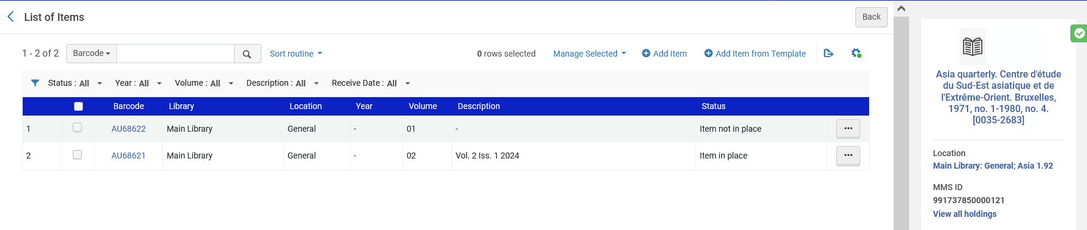
The Work Order Process
The new item with new barcode is created and the description may be edited as desired.
The Process Type is automatically "Binding".
We will update the description

Slide 26
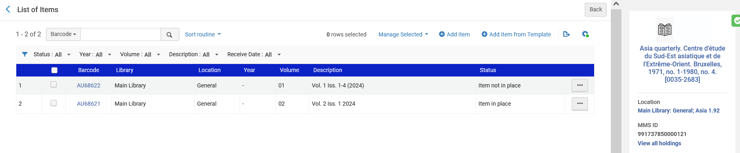
The Work Order Process
We updated the description to "Vol. 1 Iss. 1-4 (2024)"

Slide 27
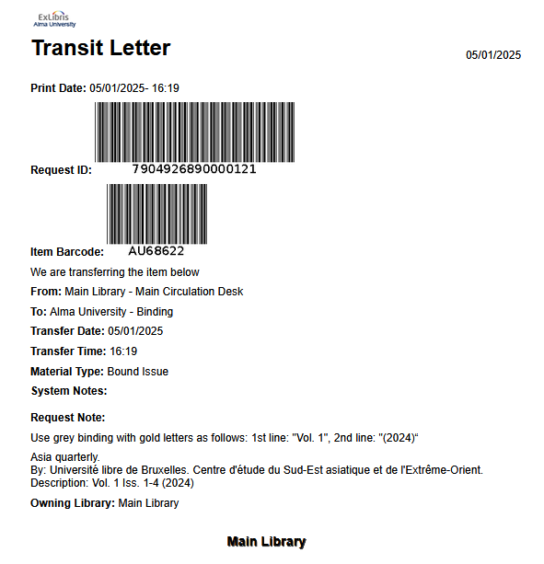
The Work Order Process
A transit letter to the binding department is printed (depending on printing setup)
This is the note we earlier added to the work order

Slide 28
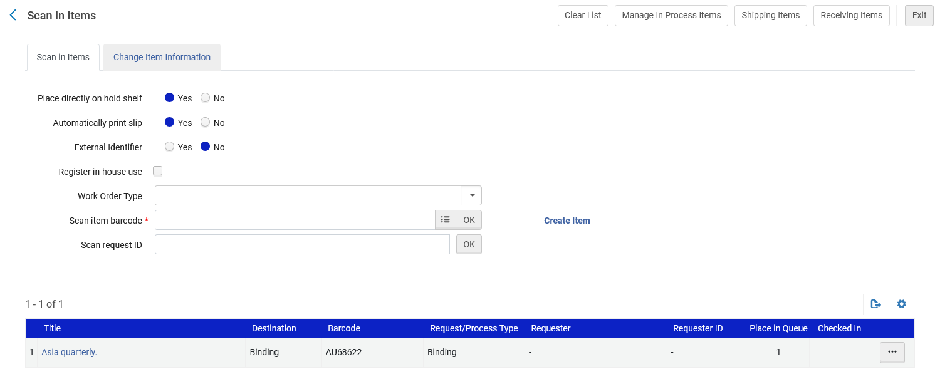
The Work Order Process
The item is scanned in (Fulfillment > Resource Requests > Scan In Items) and goes into transit to the binding department

Slide 29
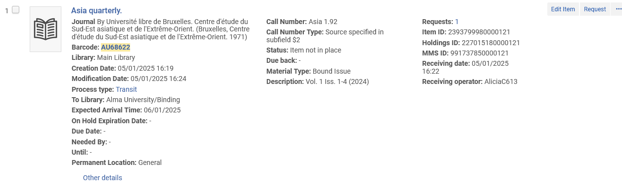
The Work Order Process
In Alma the item appears in transit to the Binding Dept.

Slide 30
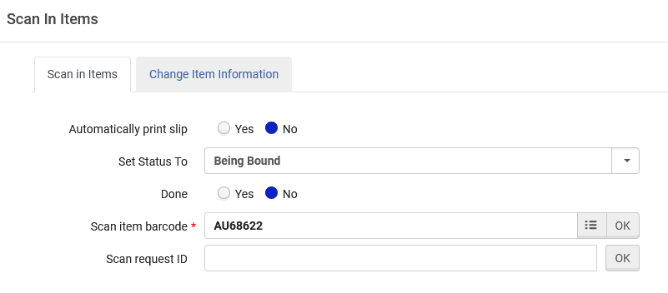
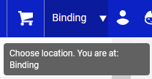
The Work Order Process
A staff user is at the binding department and scans in the item (Fulfillment > Resource Requests> Scan in Item).
The staff user chooses status "Being Bound" from a list of statuses which were already configured for this work order type.

Slide 31
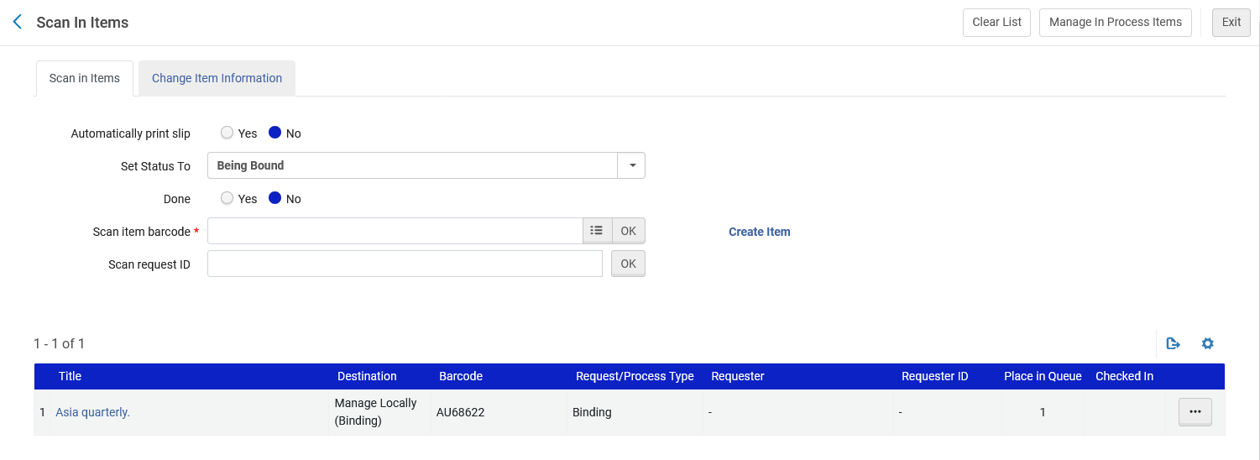
The Work Order Process
The item is being handled at the binding department

Slide 32
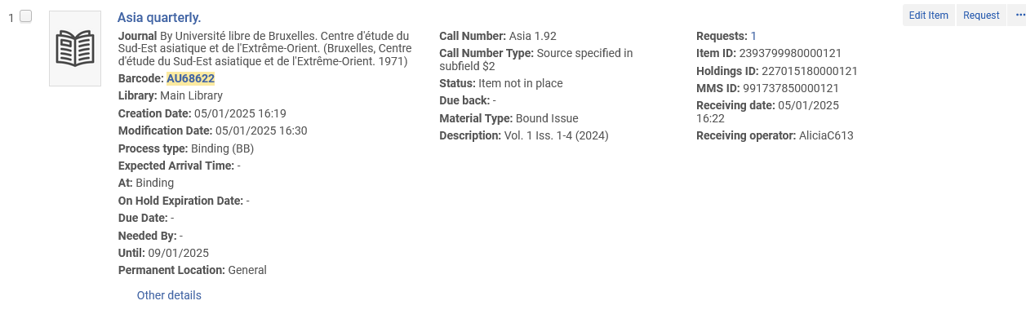
The Work Order Process
In Alma the staff user can see where the item is

Slide 33
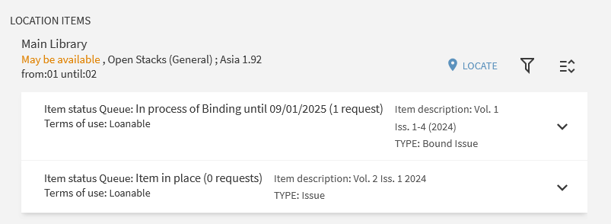
The Work Order Process
In discovery it also appears as being bound

Slide 34
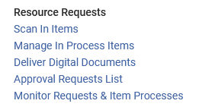
The Work Order Process
While at the Binding Dept. the "Fulfillment > Resource Requests > Manage In Process Items" link will show all items in the department and allow the staff user to manage the item.

Slide 35
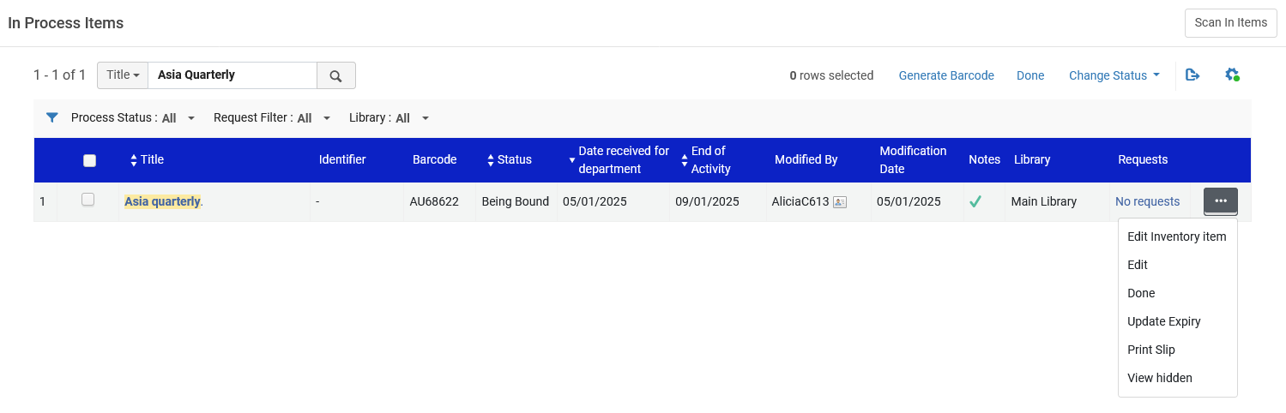
The Work Order Process
From the "Manage In Process Items" the item is found and can be changed to "Done" or edited / change to another status (among other options).

Slide 36
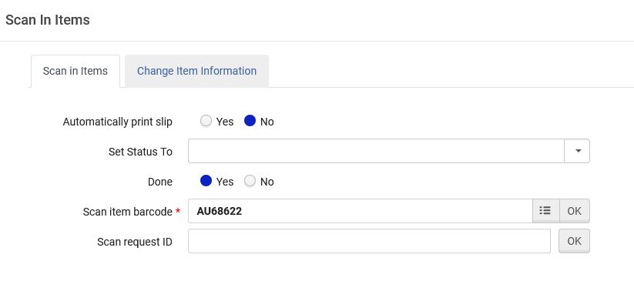
The Work Order Process
It is also possible to scan in the item (Fulfillment > Resource Requests > Scan In Items) and change the status to a different status or change the work order to "Done".

Slide 37
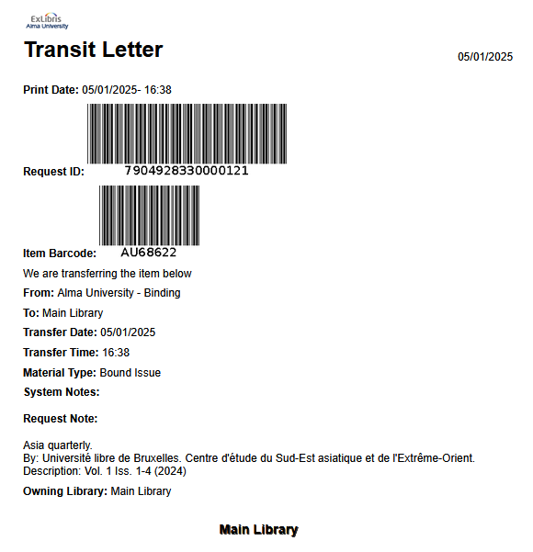
The Work Order Process
After changing work order to "Done" the item will go into transit back to the permanent location. A transit letter will print (depending on printing setup).

Slide 38
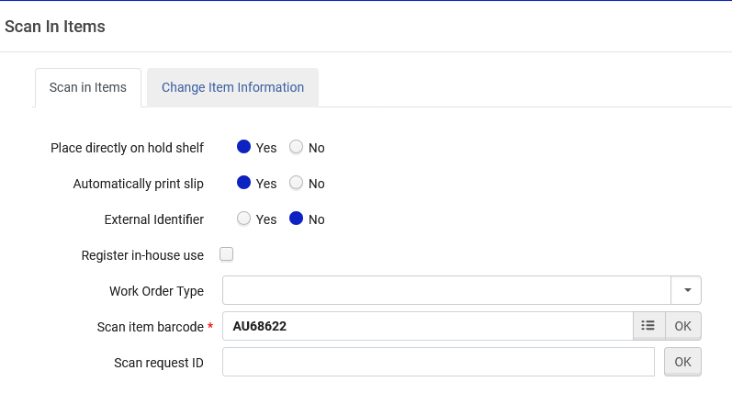
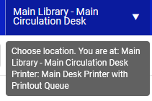
The Work Order Process
The item is scanned in (Fulfillment > resource Requests > Scan In Items) at the circulation desk of the owning library

Slide 39
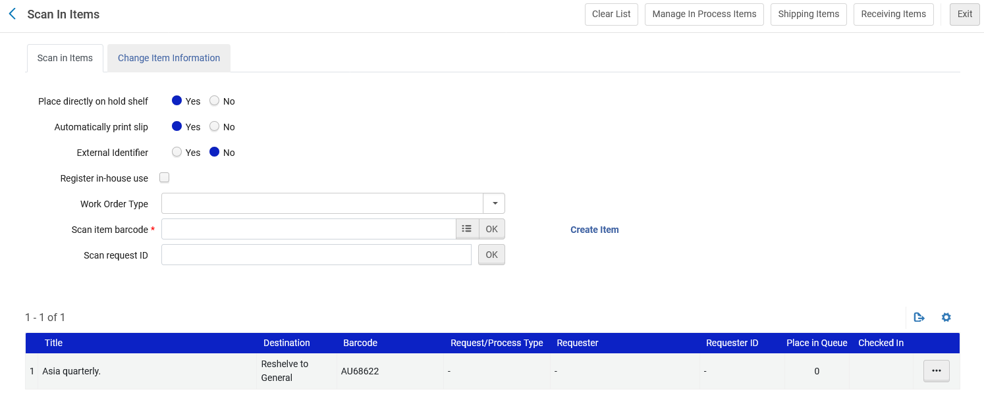
The Work Order Process
The item will be reshelved in the permanent location.

Slide 40
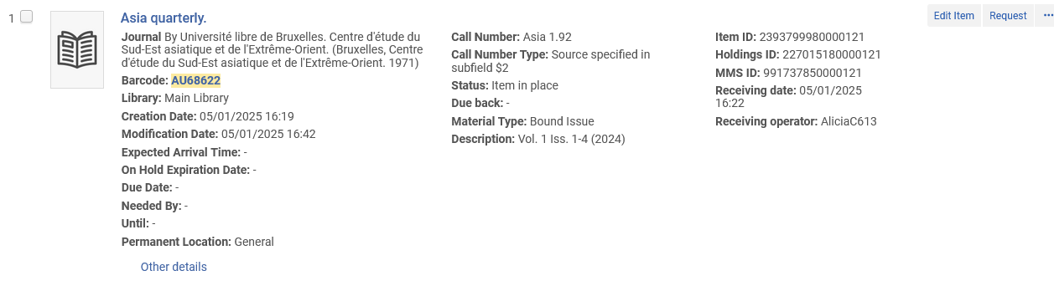
The Work Order Process
The item is now in place
Item is now in place in Alma

Slide 41
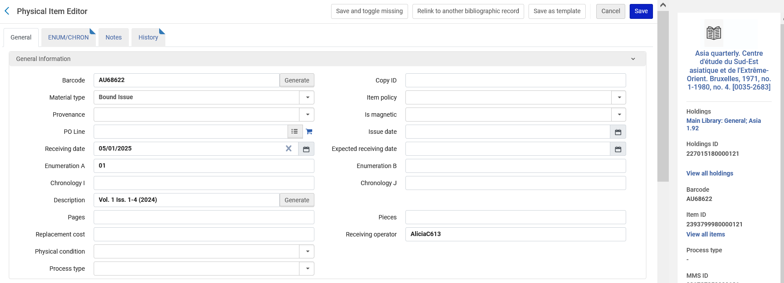
The Work Order Process
The item is a bound issue

Slide 42
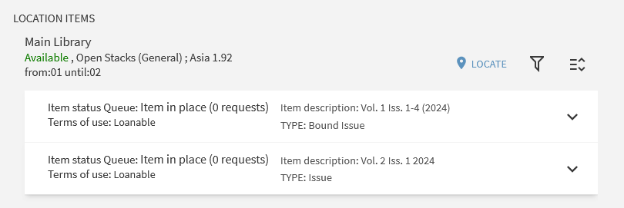
The Work Order Process
In discovery the item is now in place and appears as "Bound"

